Slide 1


Collaborative Filtering
Algorithms
Group 1
Group Member: Jing Zhao
Han Lin
Siyi Tao
Christina Huang
Hongyang Hong

Slide 2

CONTENTS
1
Data Processing
2
Memory Based Algorithm
3
Model Based Algorithm
4
Evaluation
5
Result Analysis

Slide 3
Data Processing
1. MS
Rearrange the dataset 1 by setting row to user and column to item. Assign 0 to those items which are not clicked by users
Dataset
2. Movie
Rearrange the dataset 1 by setting row to user and column to item. Assign NA to those items which are not rated by users

Slide 4
Memory Based Algorithm
Similarity Weight
Pearson
Spearman
Vector Similarity
Simrank
Significance Weighting
No
Yes
Similarity Weight
项目三
您的内容打在这里，或者通过复制您的文本后，在此框中选择粘贴，并选择只保留文字。您的内容打在这里，或者通过复制您的文本后，在此框中选择粘贴，并选择只保留文字。
您的内容打在这里，或者通过复制您的文本后，在此框中选择粘贴，并选择只保留文字。您的内容打在这里，或者通过复制您的文本后，在此框中选择粘贴，并选择只保留文字。
您的内容打在这里，或者通过复制您的文本后，在此框中选择粘贴，并选择只保留文字。您的内容打在这里，或者通过复制您的文本后，在此框中选择粘贴，并选择只保留文字。
Variance Weighting
No
Yes
Significance Weighting
Selecting Neighbors
Weight Threshold
Rating Normalization
Deviation for Mean

Slide 5
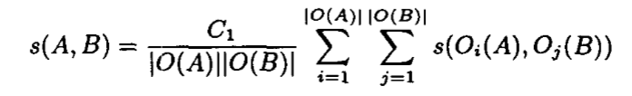
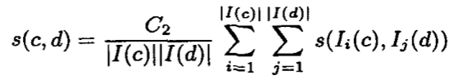
Similarity Weight
Pearson Correlation
Measures the degree to which a linear relationship exists between two variables
Spearman Correlation
Computes a measure of correlation between ranks
Vector Similarity
Cosine measure of two variables
Simrank
For the algorithm of SimRank, we mainly implement these two equations below
And since we use this algorithm for movie data, we simply set ratings larger than 4 (included) as‘like’, and smaller than 4 as ‘dislike’

Slide 6
Significance & Variance Weighting
Significance Weighting
If two users had fewer than 50 commonly rated items, we applied a significance weight of n/50, where n is the number of co-rated items.
If there were more than 50 co-rated items, then a significance weight of 1 was applied.
Variance Weighting
The Pearson correlation can be represented as the covariance of two users’ ratings, after the ratings have been scaled to z-scores.
By incorporating a variance term, we will increase the influence of items with high variance in ratings and decrease the influence of items with low variance.

Slide 7
Neighbor Selection & Rating Normalization
Neighbor Selection - Weighting Threshold
Weighting threshold means all neighbors with absolute correlations greater than a given threshold are selected.
We set an absolute correlation threshold to 0.5 for all methods except simrank for movie dataset.
And for simrank, since the weightings are small, we set it to 0.005 to make sure the coverage is not that large.
Rating Normalization – Deviation from Mean
Implement the equation below

Slide 8
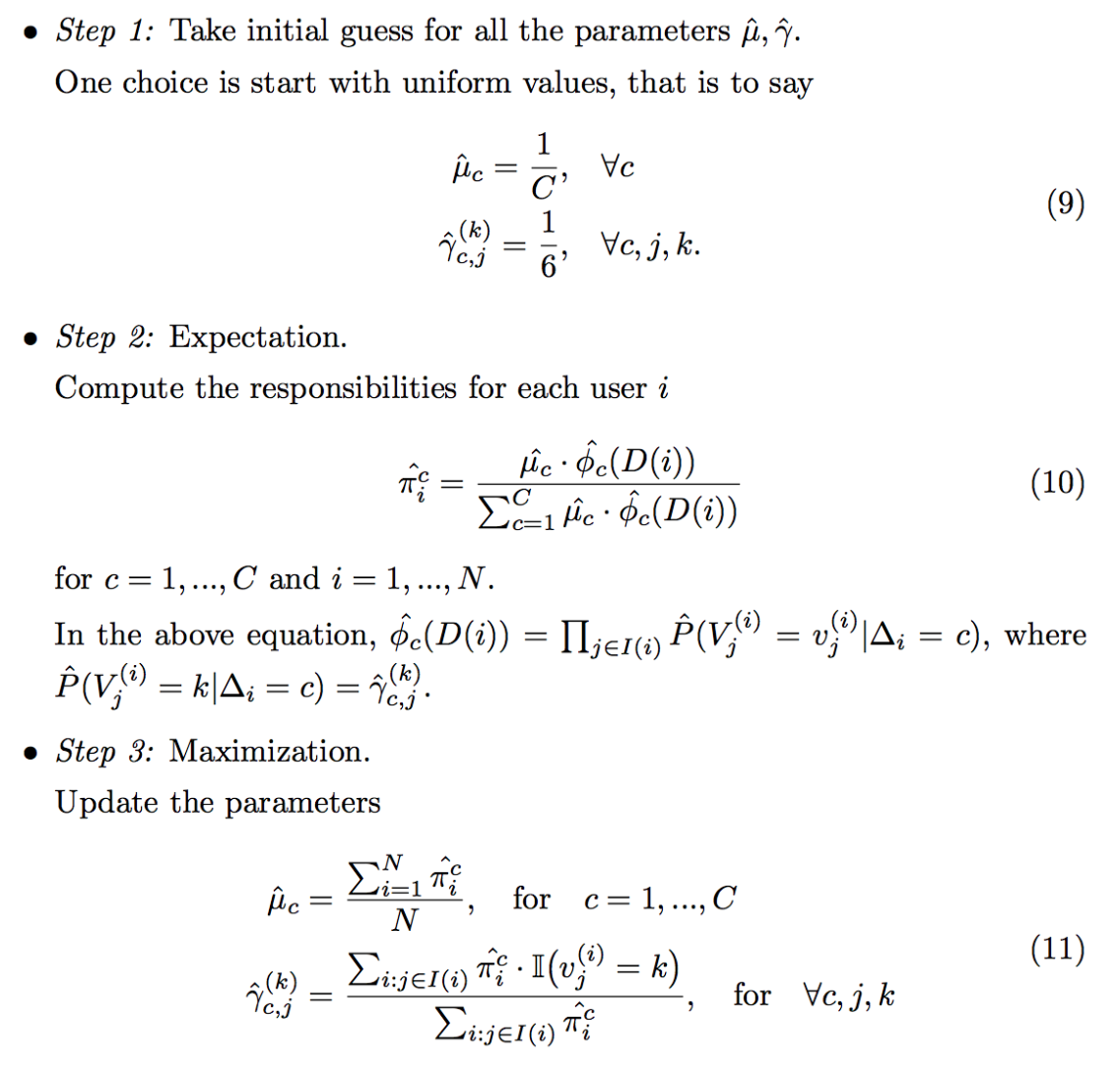
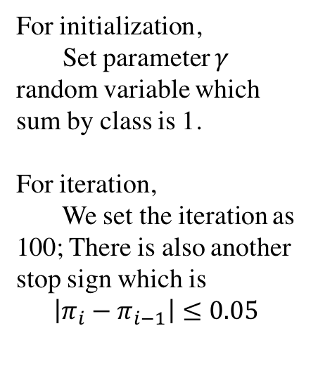
Model Based Algorithm – Cluster Model
For initialization,
Set parameter $γ$ random variable which sum by class is 1.
For iteration,
We set the iteration as 100; There is also another stop sign which is
$$\left|π_{i}−π_{i−1}\right|≤0.05$$

Slide 9
Evaluation
For this part, we applied three evaluation methods to compare the results:
For dataset 1 – Rank Score
- Rank Score
* It measures the expected utility of a ranked recommendation list Ra and normalized by the maximum achievable utility Ra_max.
* The expected utility of a list is simply the probability of viewing a recommanded item times its utility.
For dataset 2 – ROC & MAE
- Roc
* We set the filter as 4. It means when the rating is larger than 4, we think it as ‘good’ item and vise versa. Then we compare the prediction matrix and test matrix.
* Noted, the range of ROC sensitivity is 0 to 1, where 0.5 is random and 1 is perfect.
- MAE

Slide 10
Results Analysis
Rank Score | Pearson | Spearman | Vector
none | 35.63616 | 35.63616 | 36.25918
significance | 41.38228 | 41.38228 | 41.51407
variance | 42.6521 | 42.6521 | 42.85452
sig+var | 40.48851 | 40.48851 | 40.56334
MS
MAE | Pearson | Spearman | Vector | Simrank
none | 1.086954 | 1.08805 | 1.069108 | 1.049705
significance | 1.033551 | 1.204552 | 1.057466 | 1.037728
variance | 1.068782 | 1.069955 | 1.081626 | 1.251025
sig+var | 1.03158 | 1.038538 | 1.057548 | 1.062456
MOVIE
ROC | Pearson | Spearman | Vector | Simrank
none | 0.7501901 | 0.7492996 | 0.7350657 | 0.742455
significance | 0.7625856 | 0.761646 | 0.7388531 | 0.7459058
variance | 0.7396295 | 0.7391965 | 0.7496398 | 0.7371886
sig+var | 0.7532392 | 0.7518332 | 0.7611719 | 0.7431254
MOVIE
Red
Orange
Yellow:
Green
Large
:
Small

Slide 11
Results Analysis
Pearson performs better than the other 3 methods when only similarity correlation implemented.
All the similarity correlation methods improve a lot when combined with significance weighting.
Except vector similarity, the other 3 methods perform even worse when variance weighting implemented

Slide 12
Results Analysis
Vector similarity and simrank work well with significance weighting but not with variance weighting
Pearson performance achieve the best with significance weighting and variance weighting, and so does the Spearman correlation.

Slide 13
Results Analysis
Pearson correlation and Spearman correlation are the same for dataset MS dataset
Vector similarity performs much better for MS dataset

Slide 14
Results Analysis
26.35
We have tried 2, 3, 5, 10 to tune the parameter of cluster number.
And Obviously when cluster number is 3, it gives us a better prediction.

